Slide 1

André Araújo e Sá
Sales Manager

Slide 2
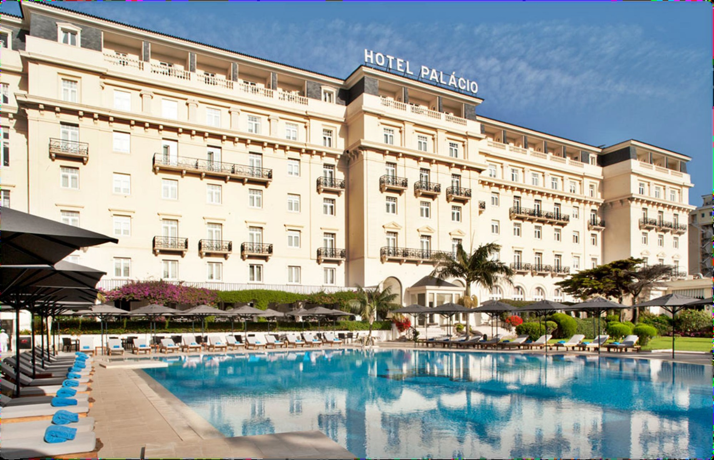






Slide 3

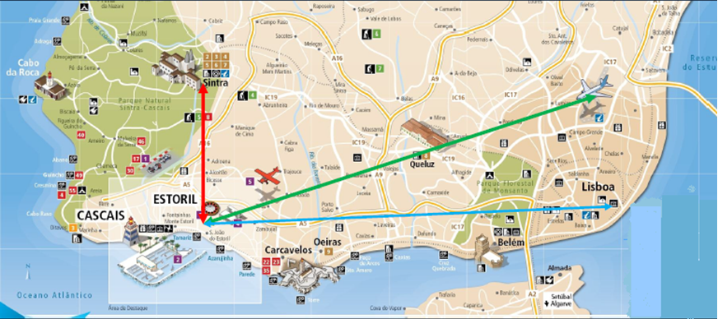
Estoril coast is the Portuguese Riviera
Airport – 30 km
Lisbon city centre – 24 km
Sintra – 15 Km
Aeroporto-Hotel--- 29,8Km
Lisbon Centro-Hotel---24,1Km
Hotel-Sintra---14,8Km

Slide 4
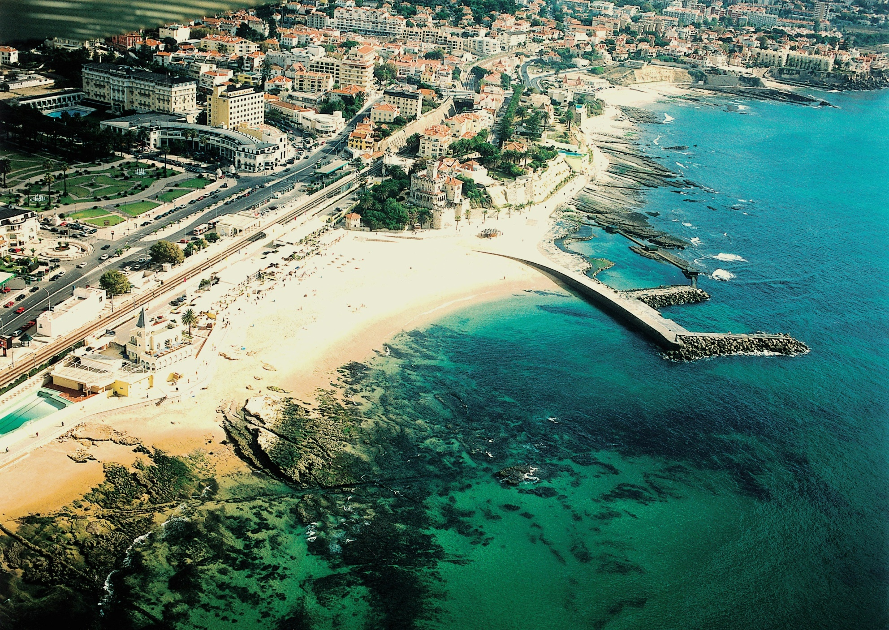
One of the most noble regions of Portugal

Slide 5
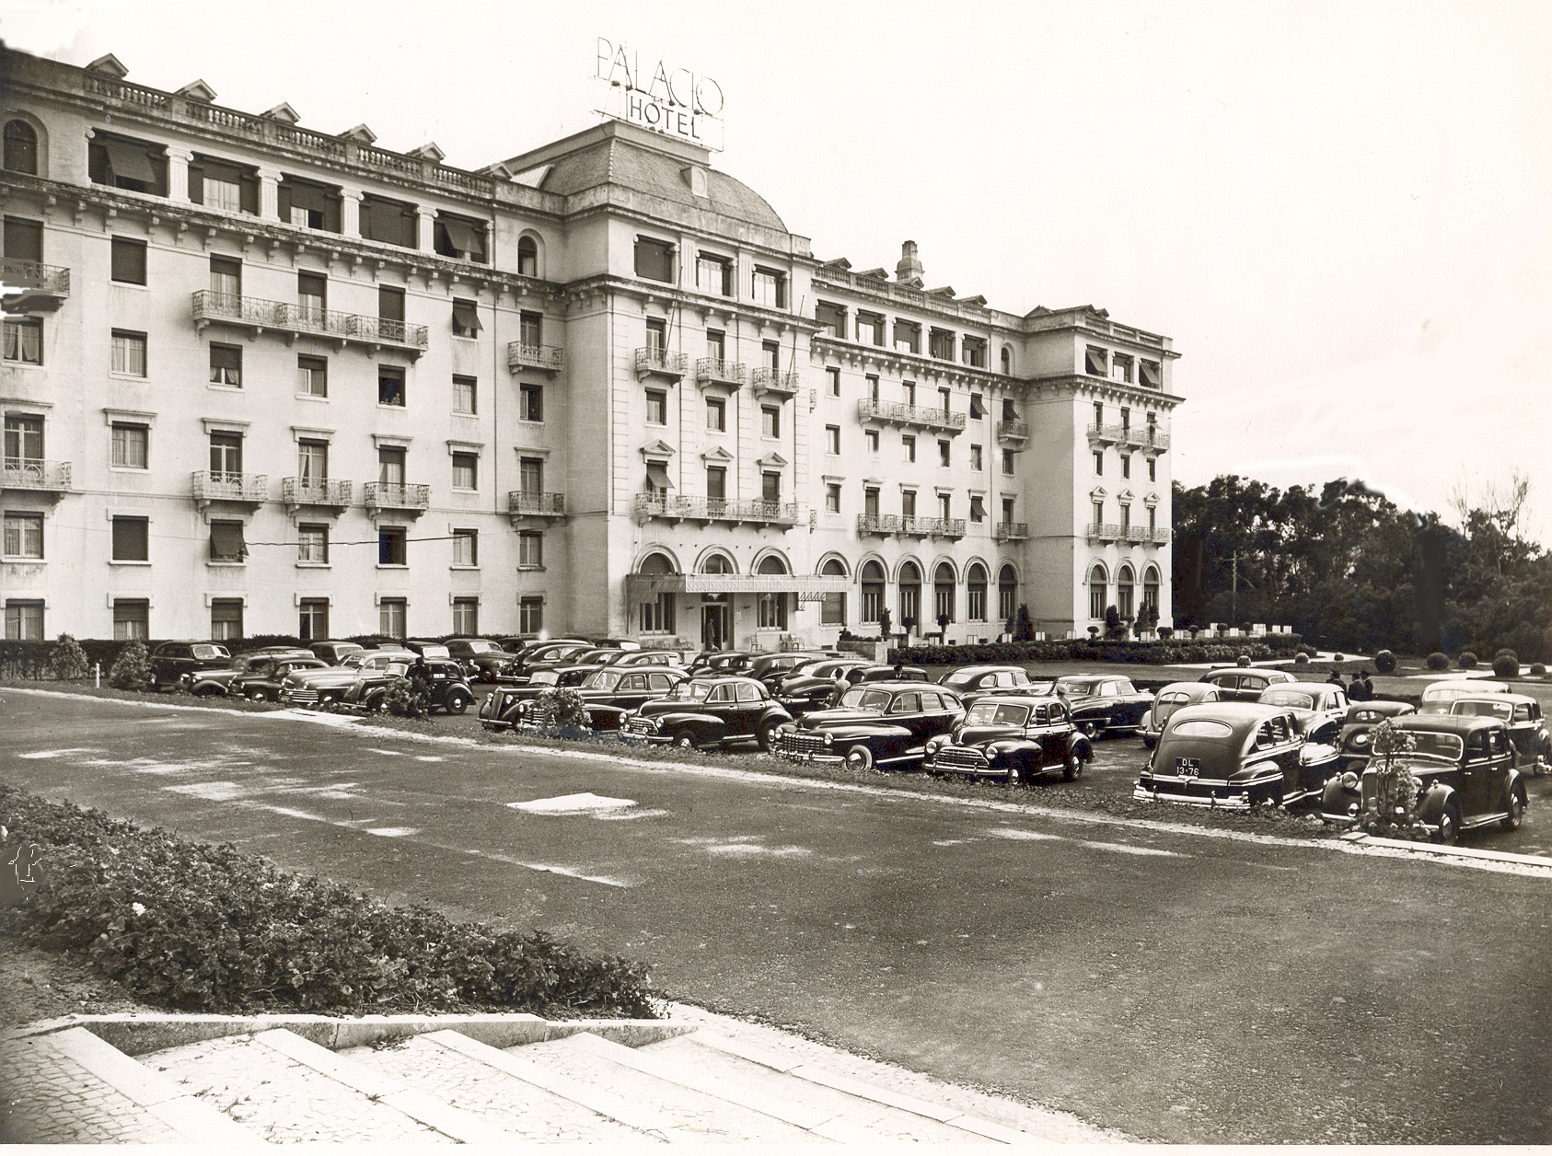
Hotel Palácio Estoril opened in 1930…

Slide 6
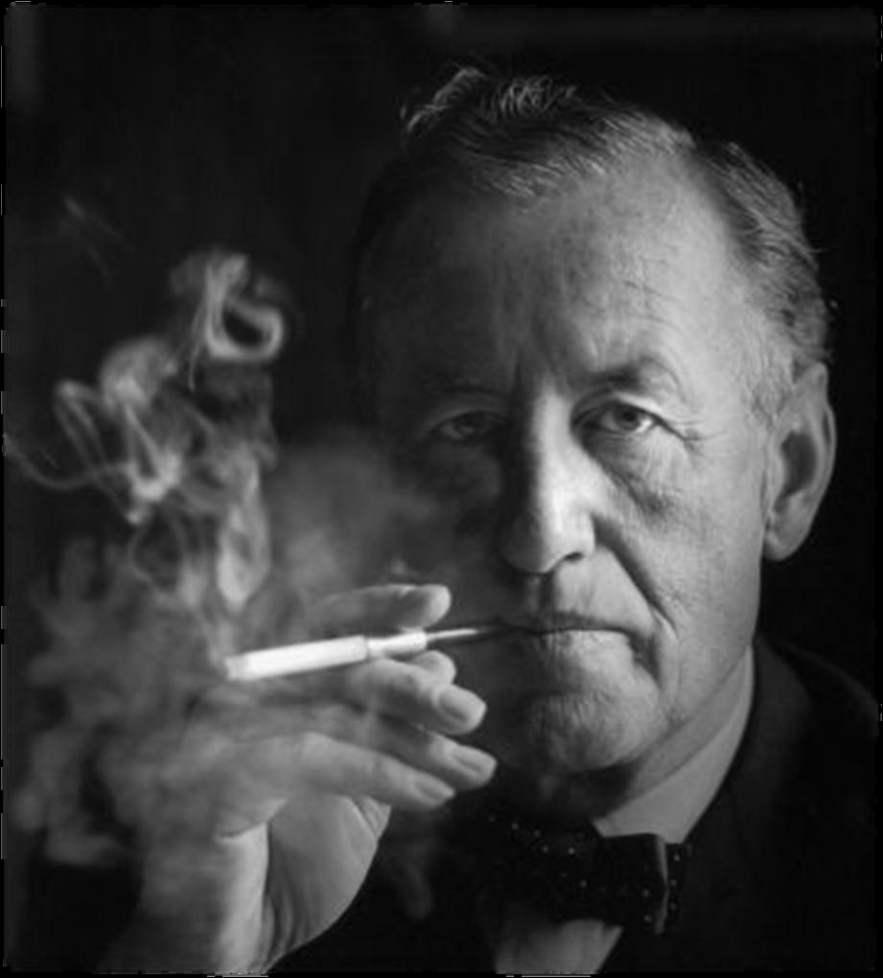
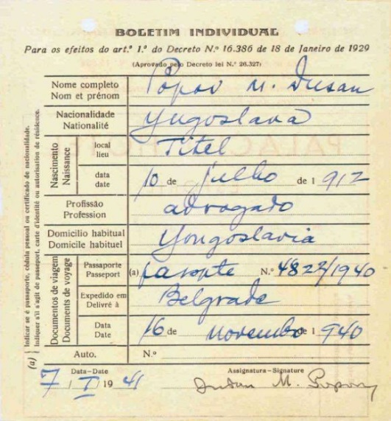
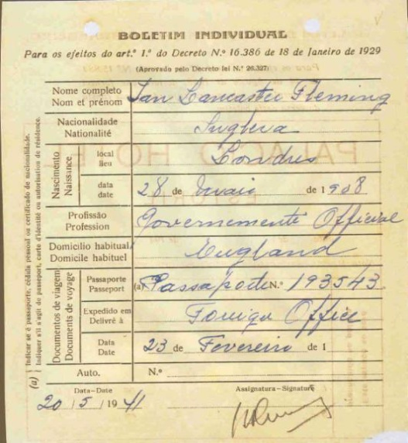
Ian Fleming and Dusko Povov…
Two of the spies who stayed in the Palácio during the 2nd world war.

Slide 7

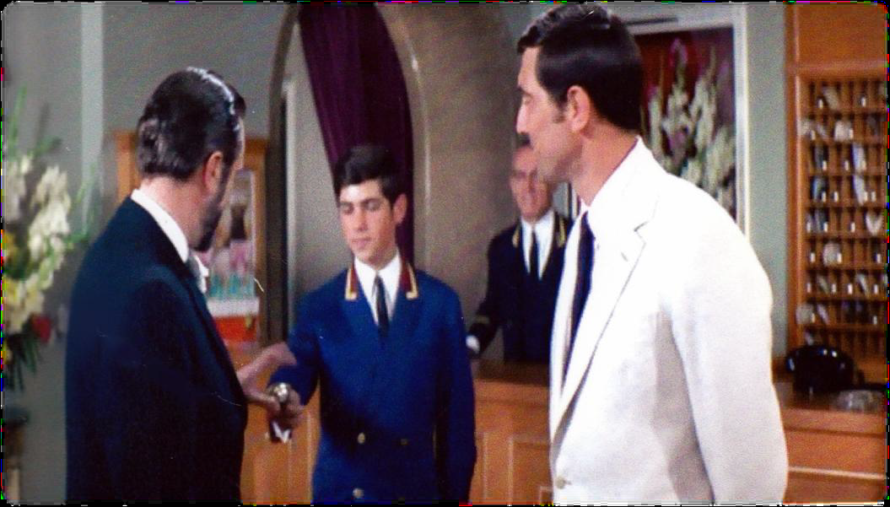
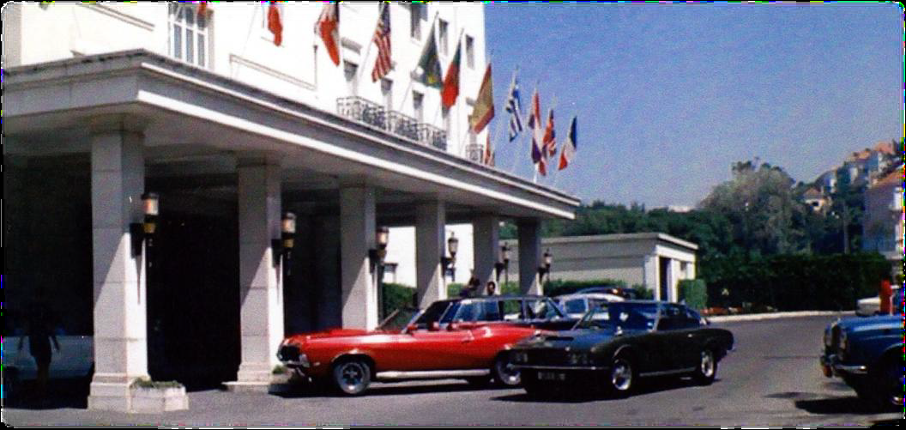
The Palacio was chosen to be part of the film “On Her Majesty’s Secret Services, in 1968
“ Everything seems up to the Palácio ‘s usual,high standards”
George Lazenby – James Bond 1968

Slide 8
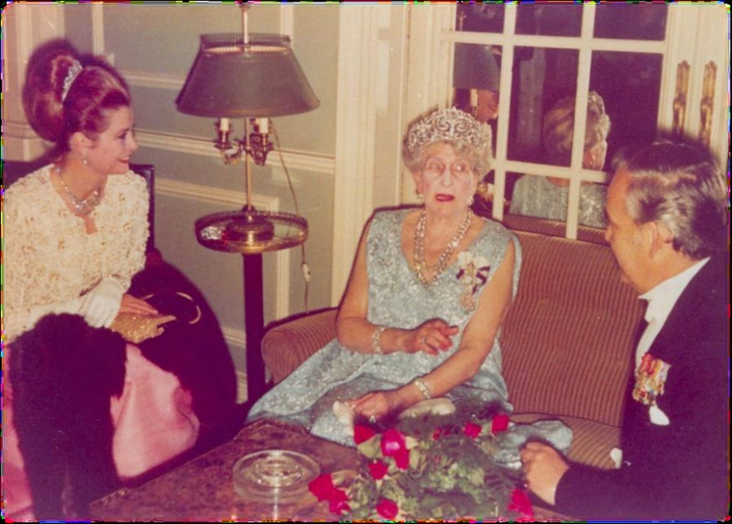
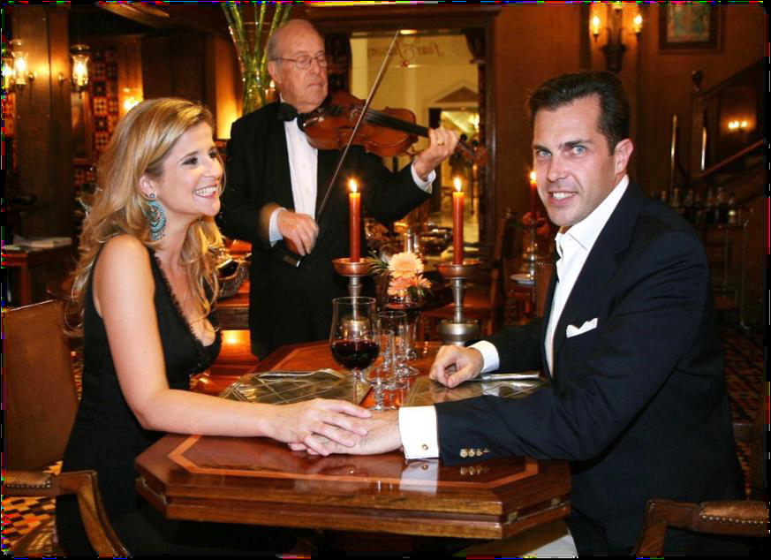
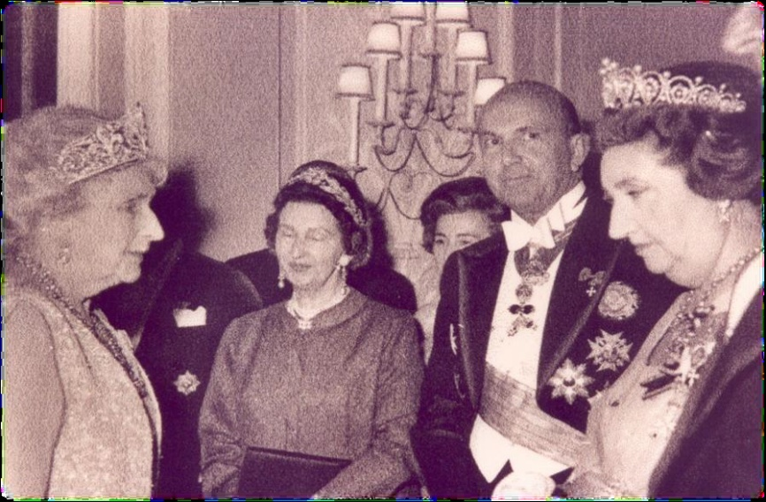
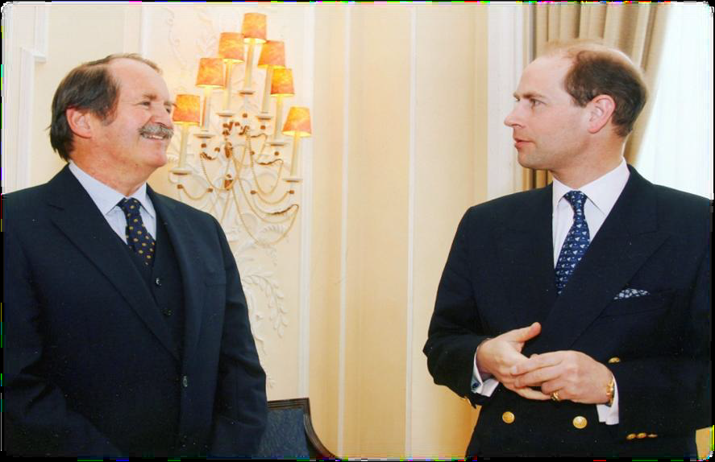
Estoril is the main destination of the European Aristocracy

Slide 9
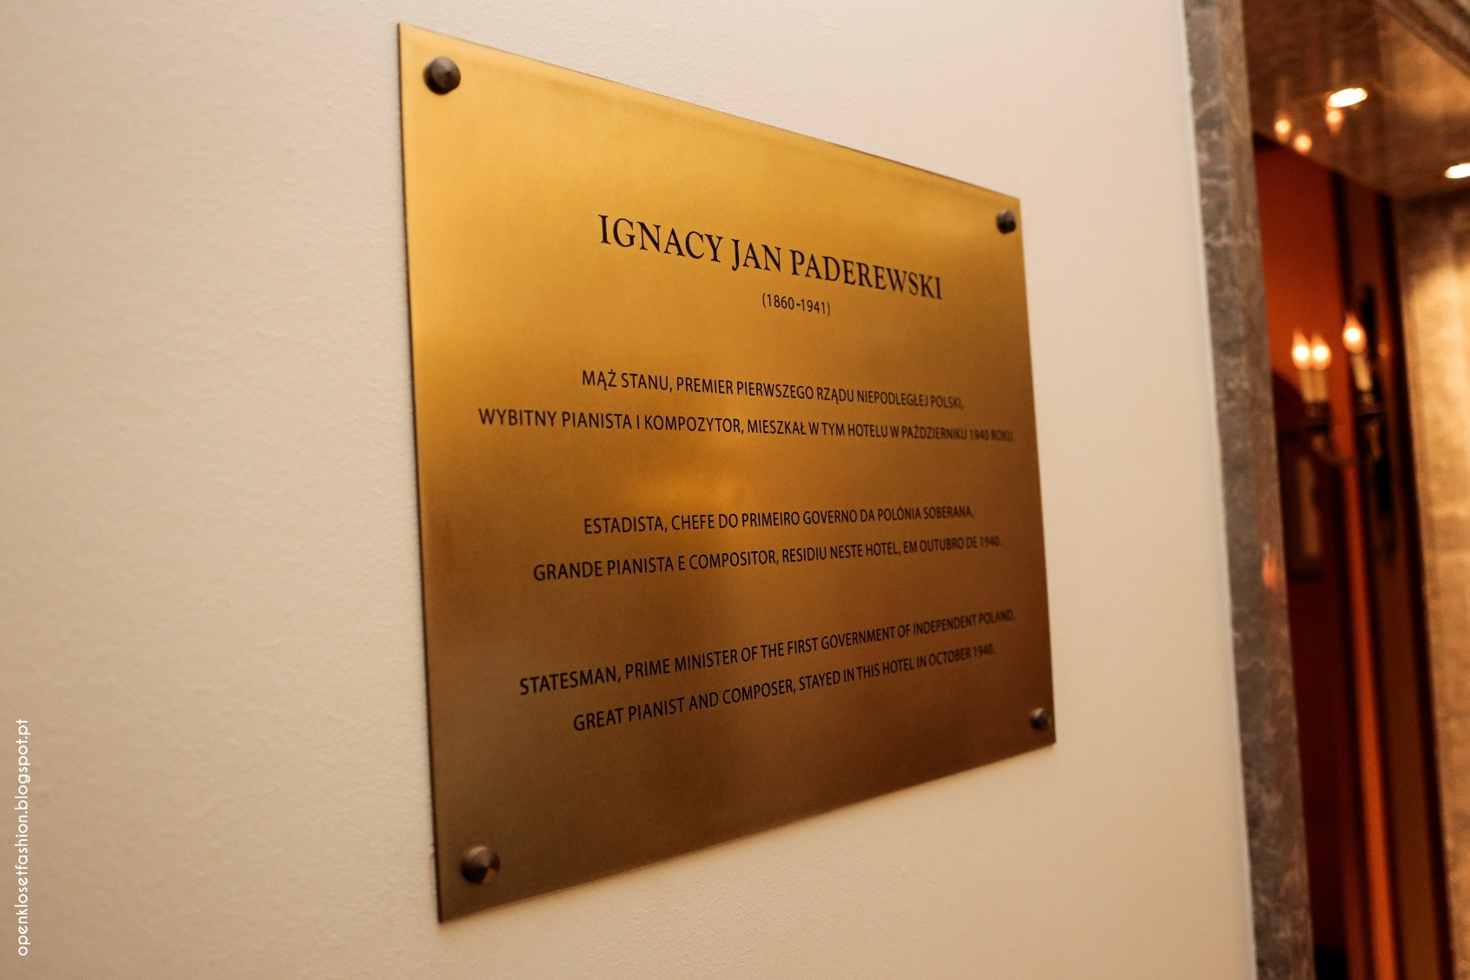
Also Polish important personalities choose the Palácio as home…

Slide 10
Prime location…

Slide 11
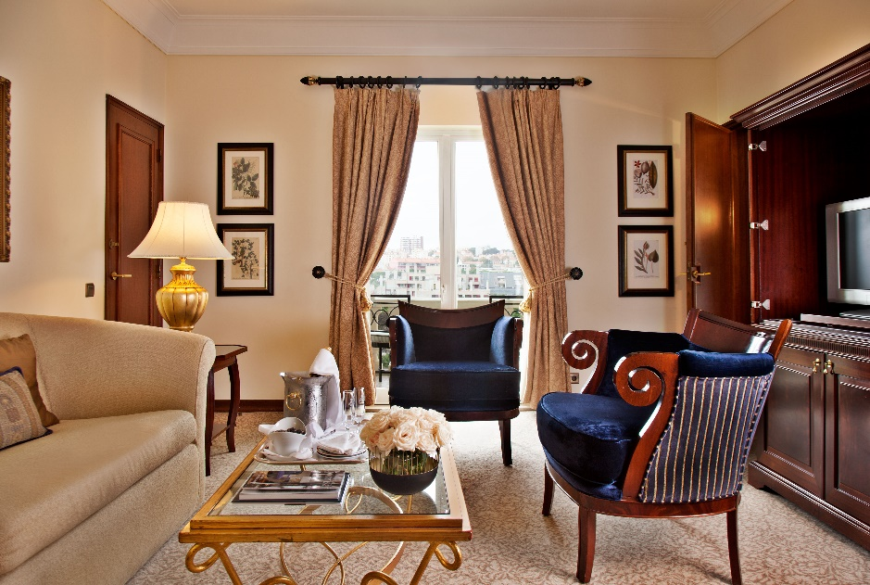
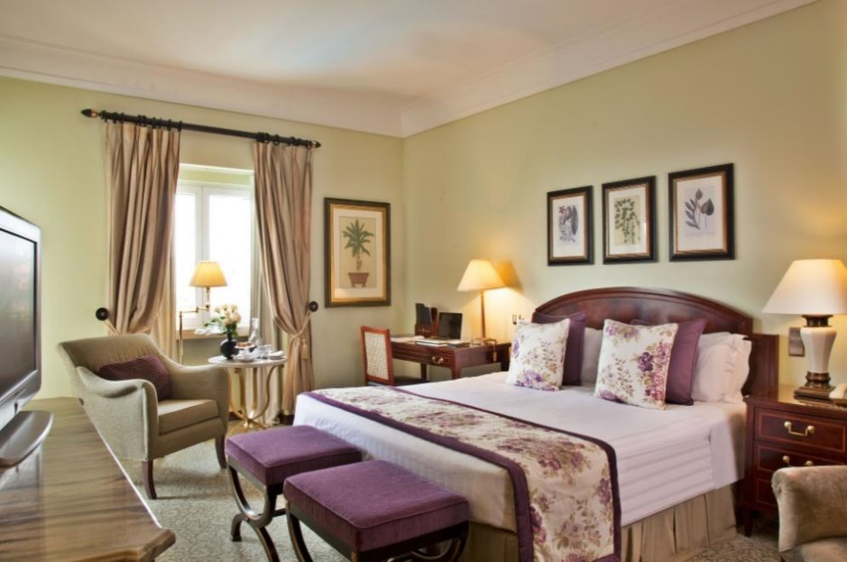
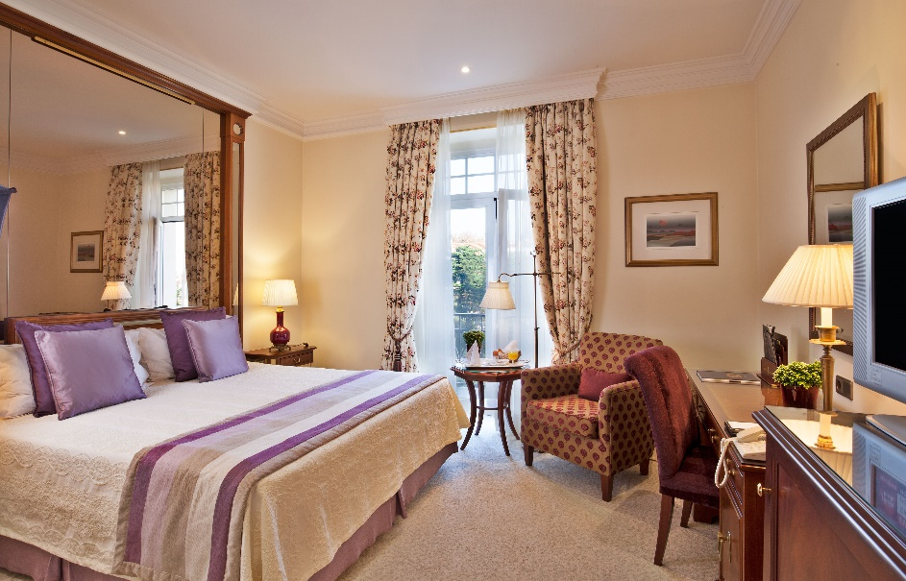
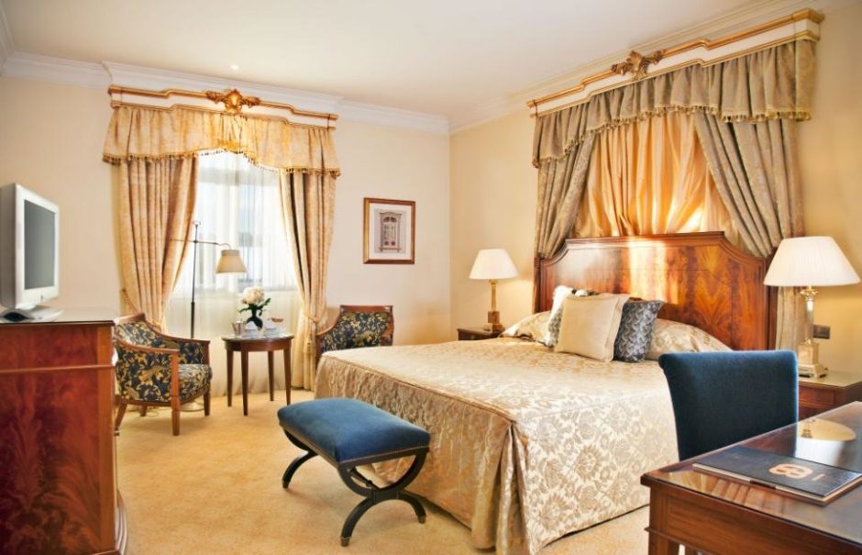
“ The housekeeping staff is so wonderful… They really made me feel
welcome ‘Home’.” Diana Ross

Slide 12
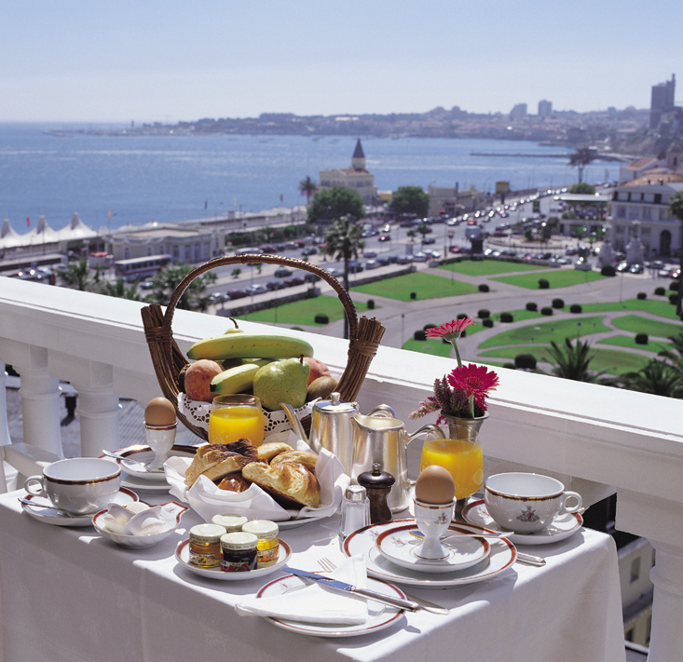
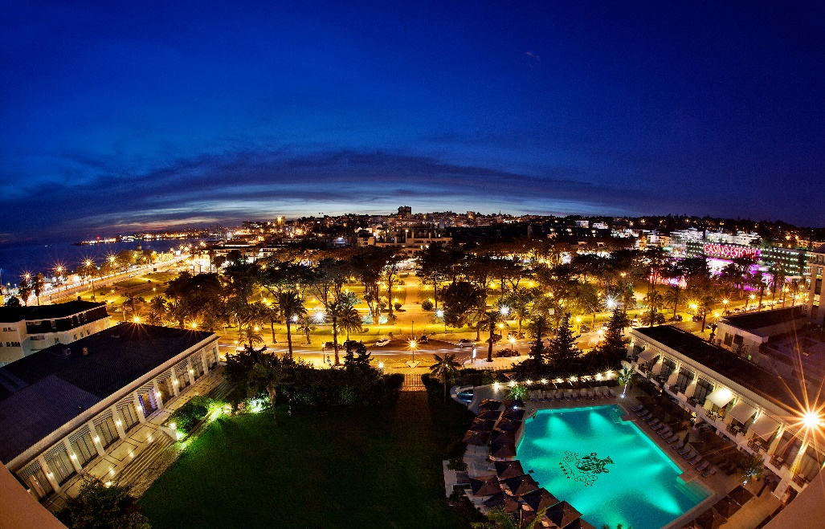
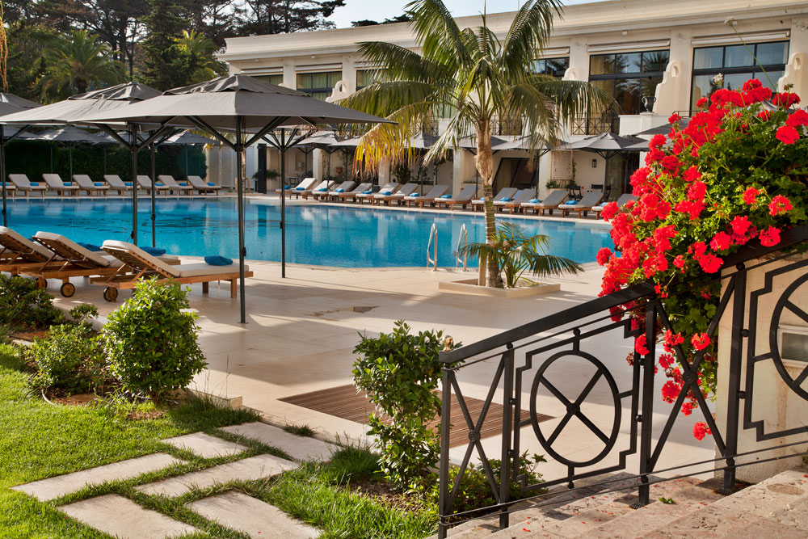
“We had a wonderful time – The service is superb.”
Joan Baez

Slide 13
9 conference rooms, capacity up to 500 people

Slide 14
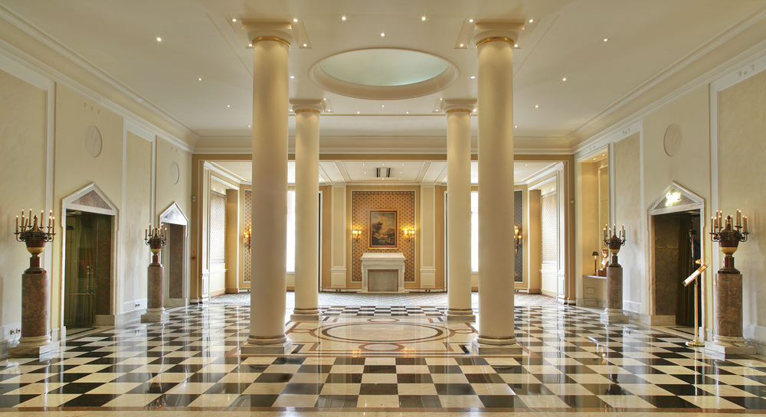
Rooms full of elegance for special events

Slide 15
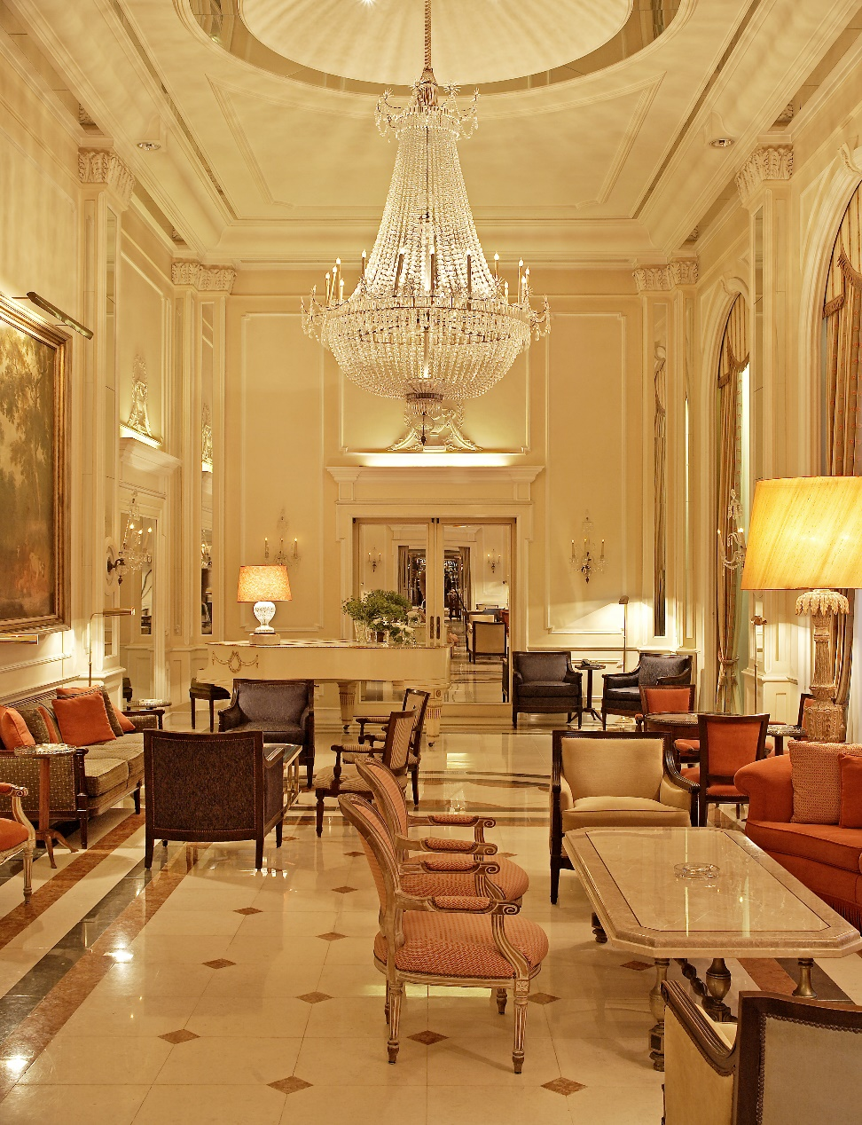
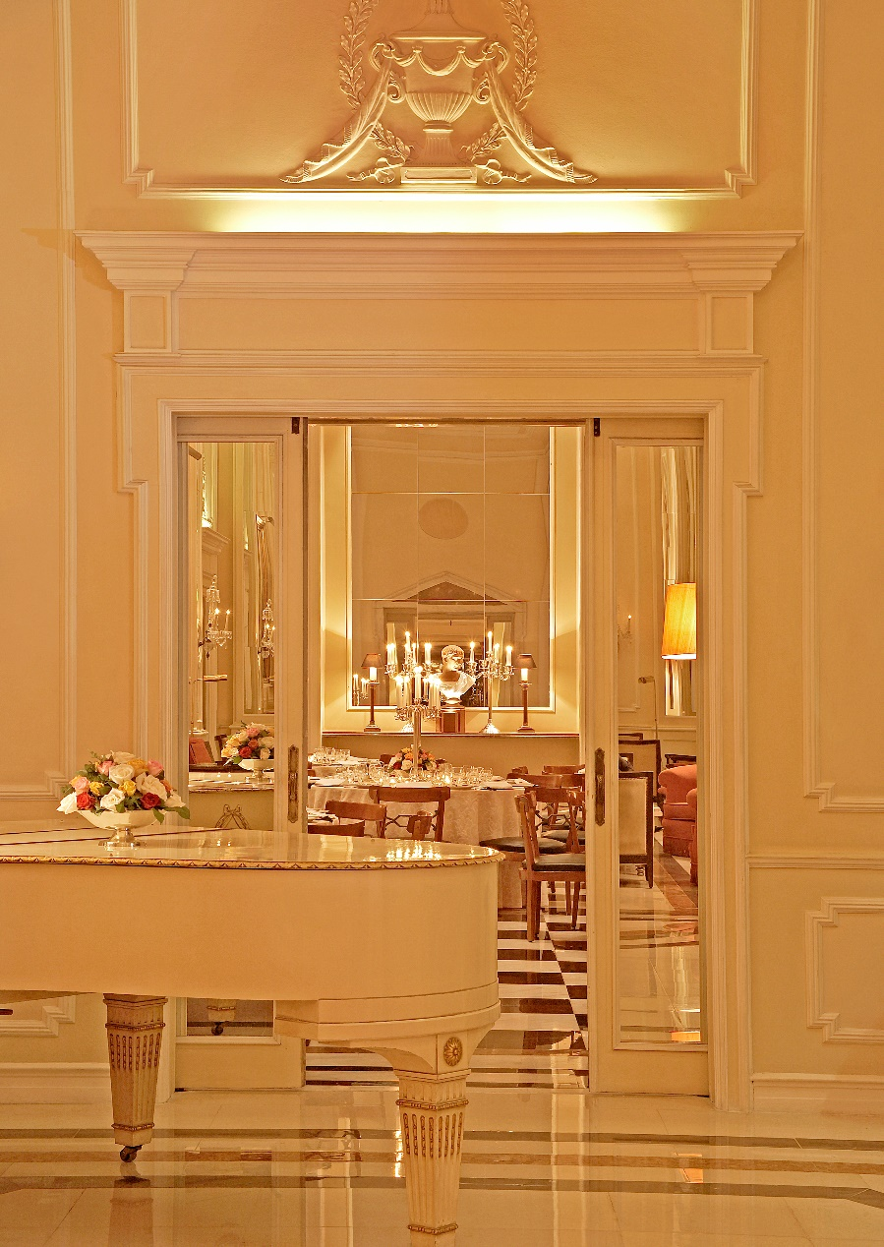
Imperial room – Glamour and charm atmosphere

Slide 16
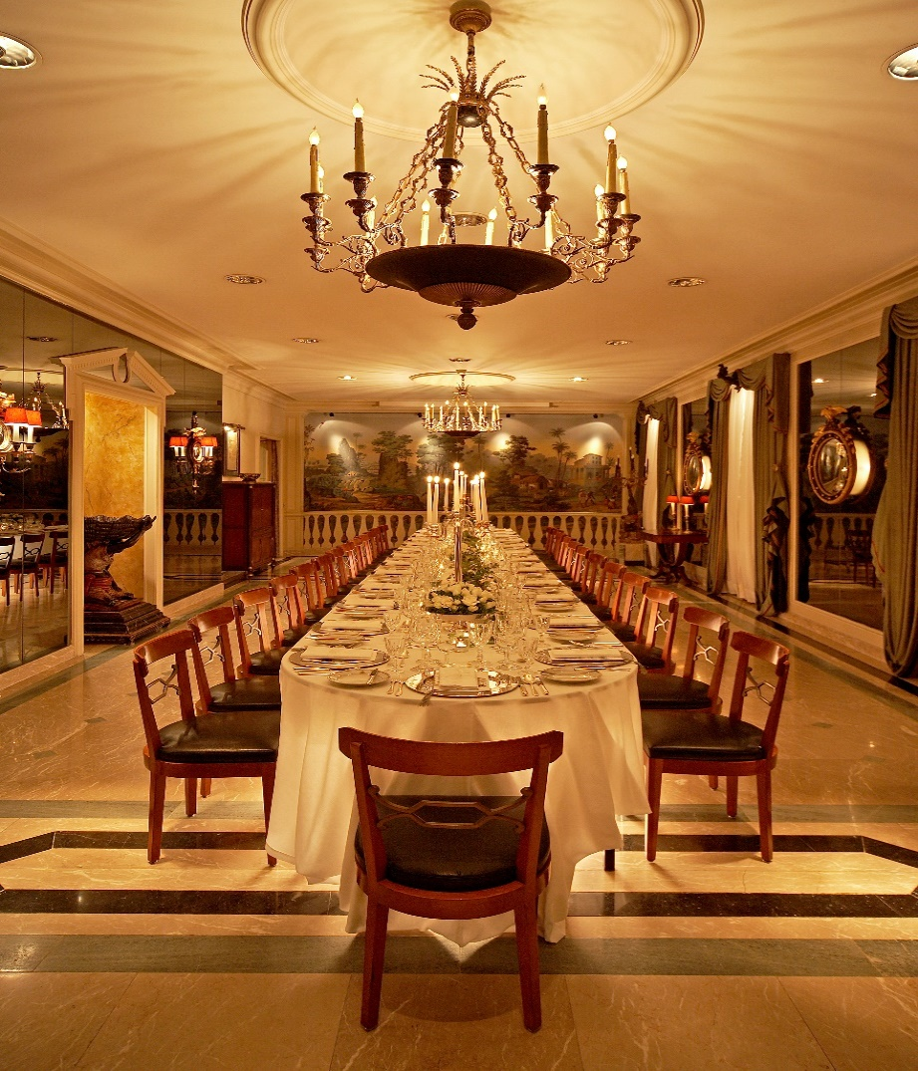
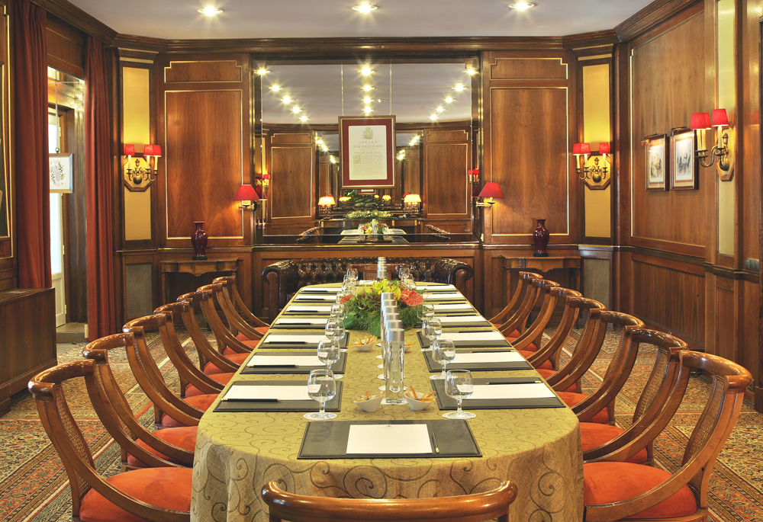
“Wonderful to be here, in such a beautiful hotel.”
Chris de Burgh

Slide 17
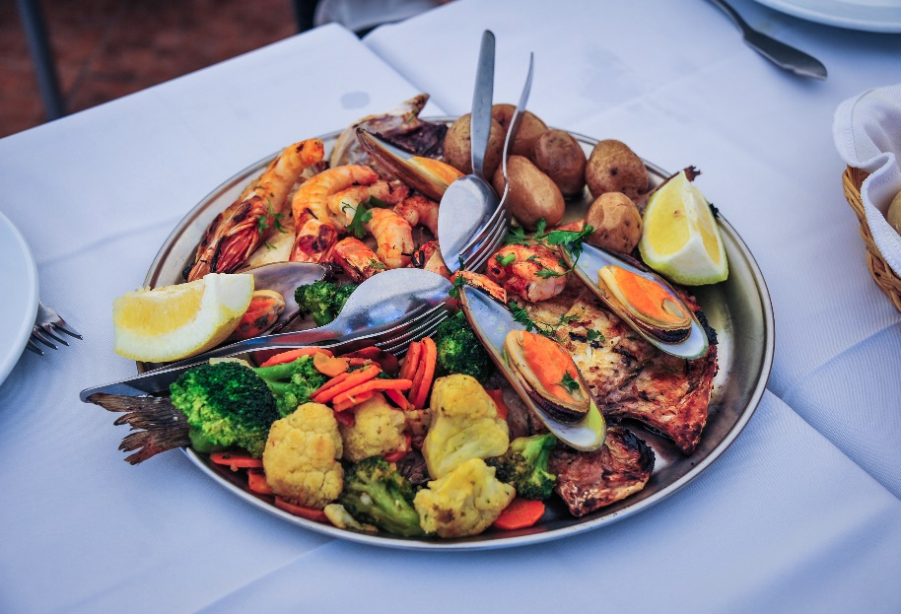
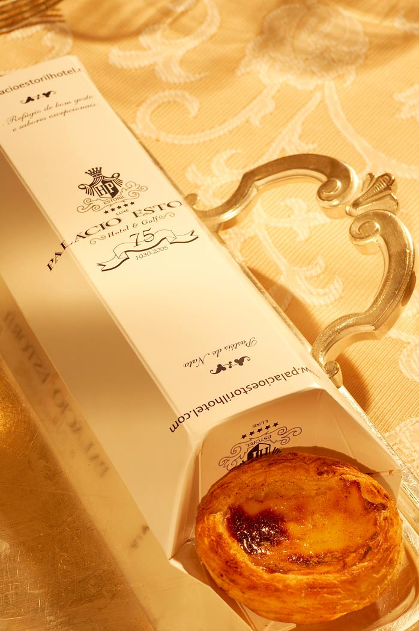
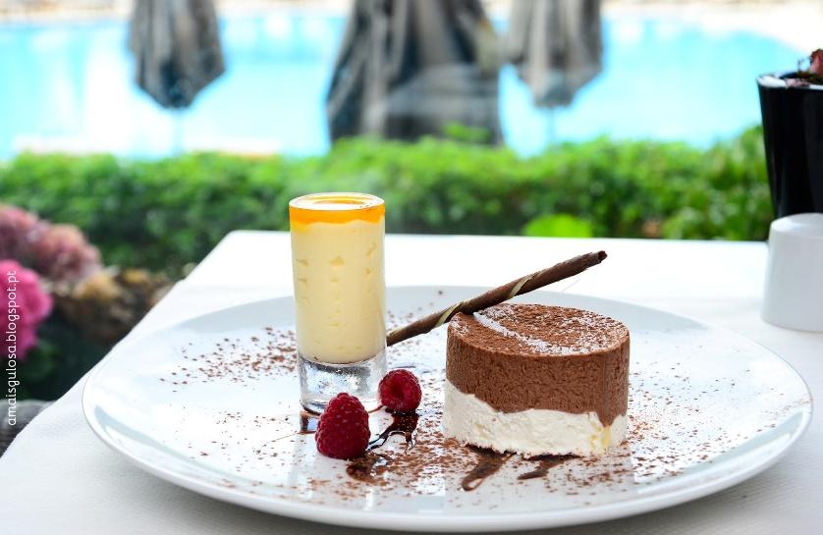
Portuguese gastronomy…
Fish, wine and delicious pastries

Slide 18
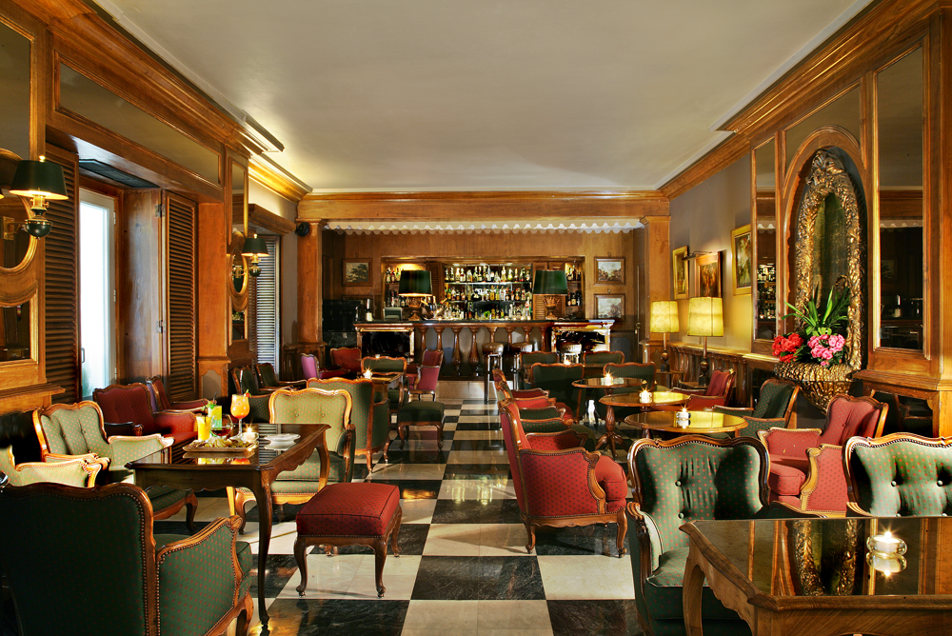
The Estoril bar, where Jan Fleming got inspired to write the first book of 007 “Casino Royal”

Slide 19
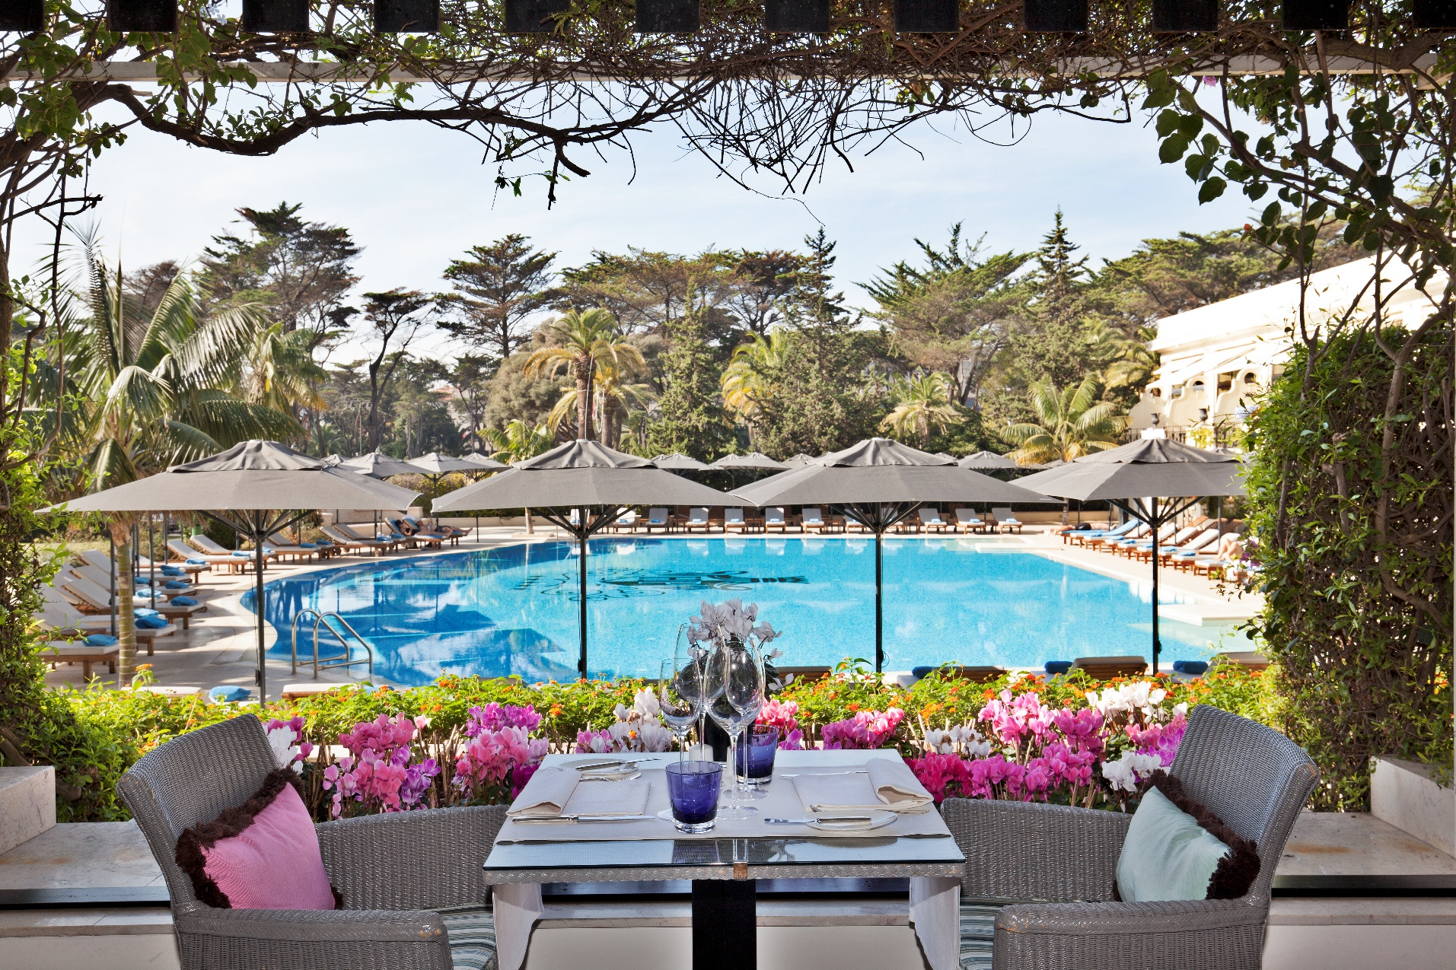
Bougainvillea Terrace with wonderful views to the pool and the casino Estoril gardens

Slide 20
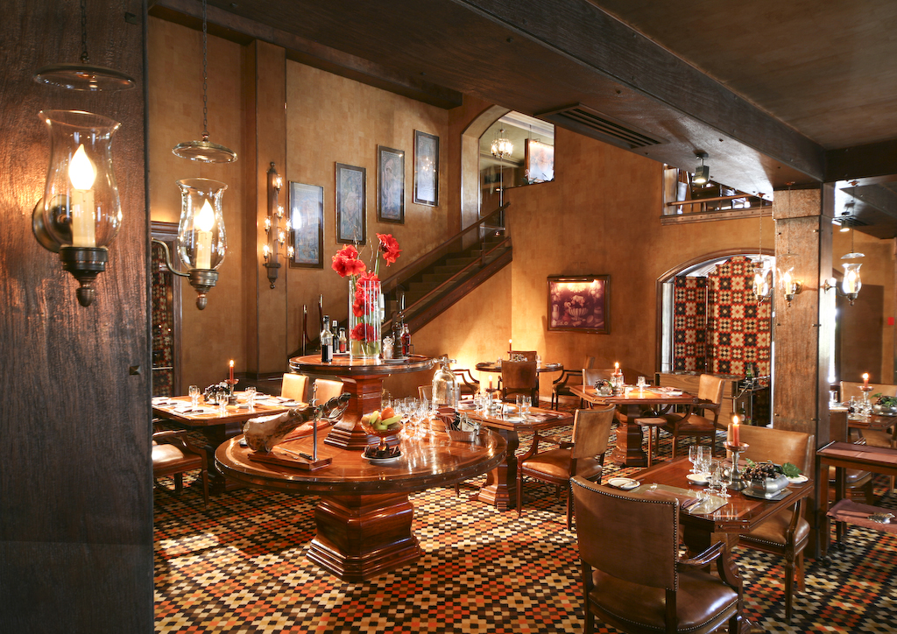
Our Grill Four Seasons – A fine dinning restaurant with portuguese and international cuisine.

Slide 21
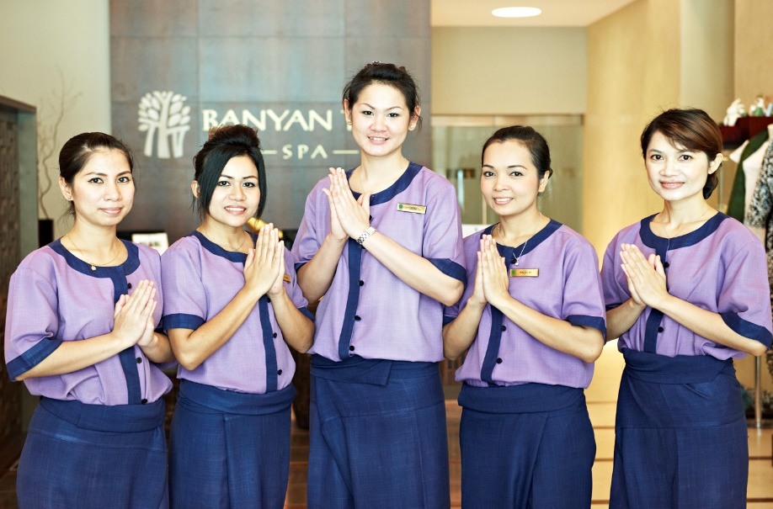
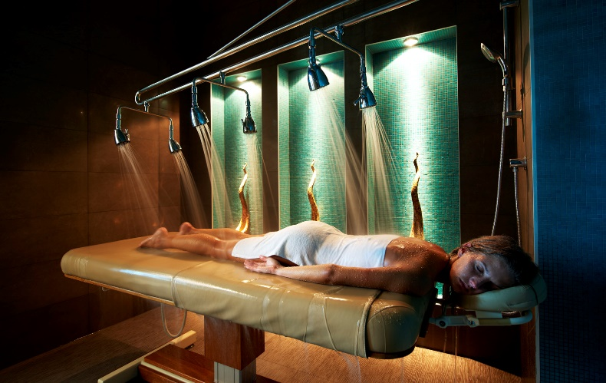
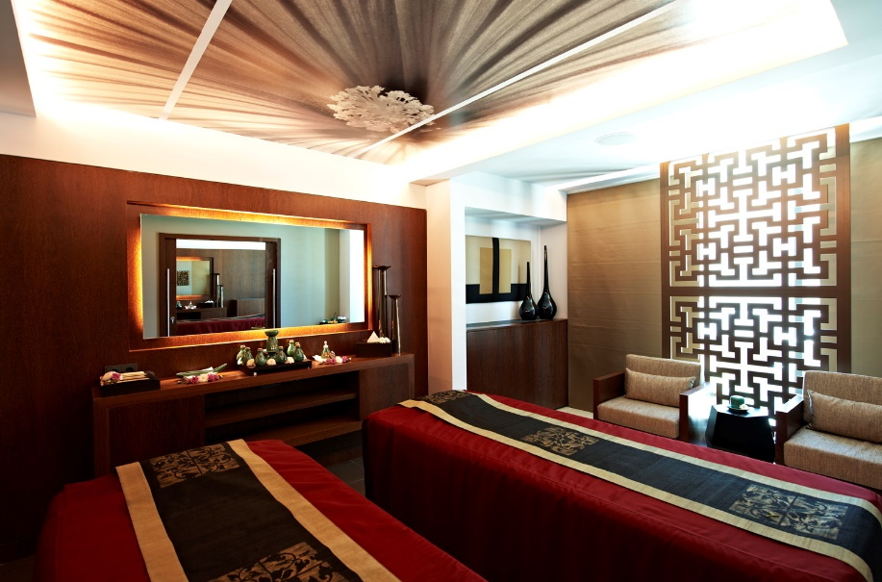
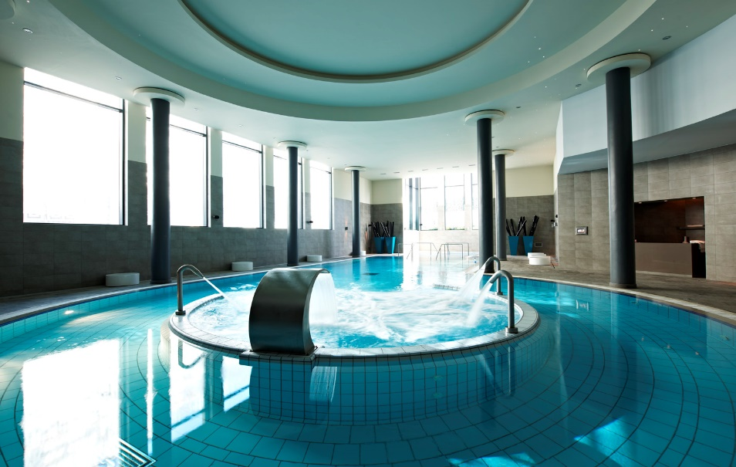
Banyan Tree Spa – Wellness, Harmony and tranquility…

Slide 22
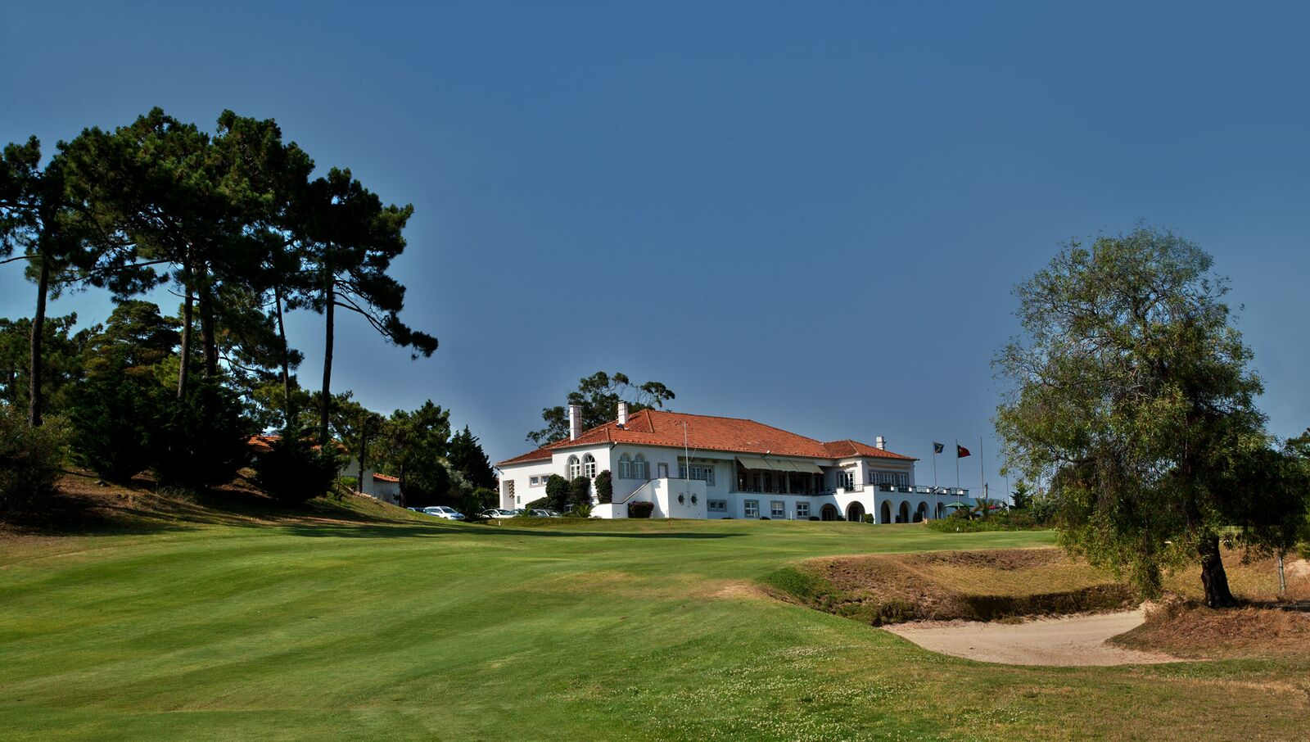
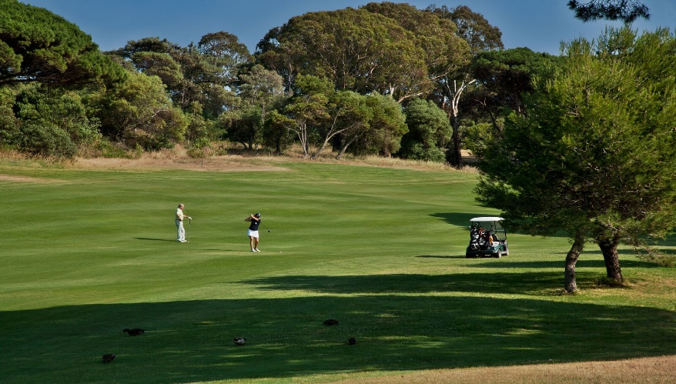
Estoril Golf – One of the best Golf courses of Portugal

Slide 23
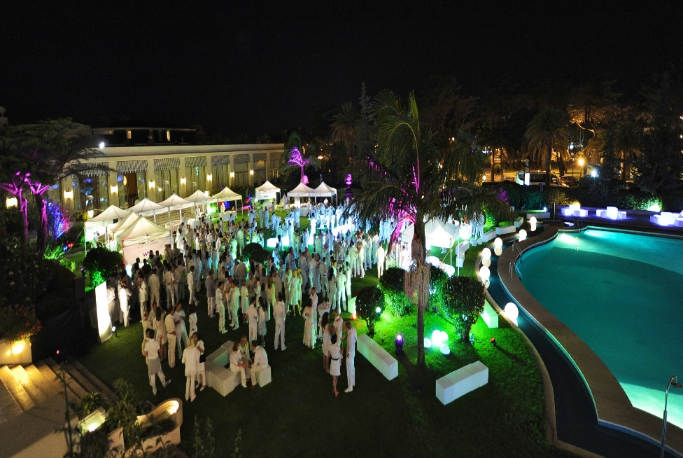
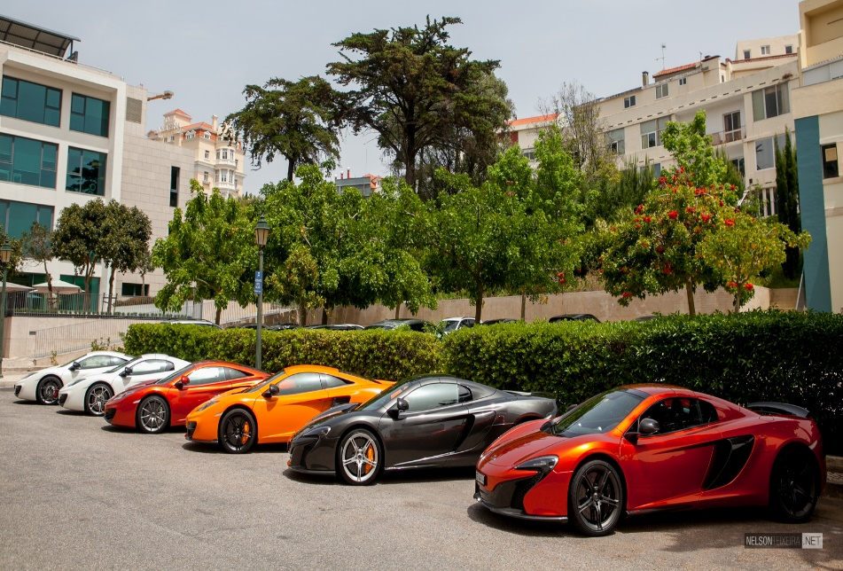
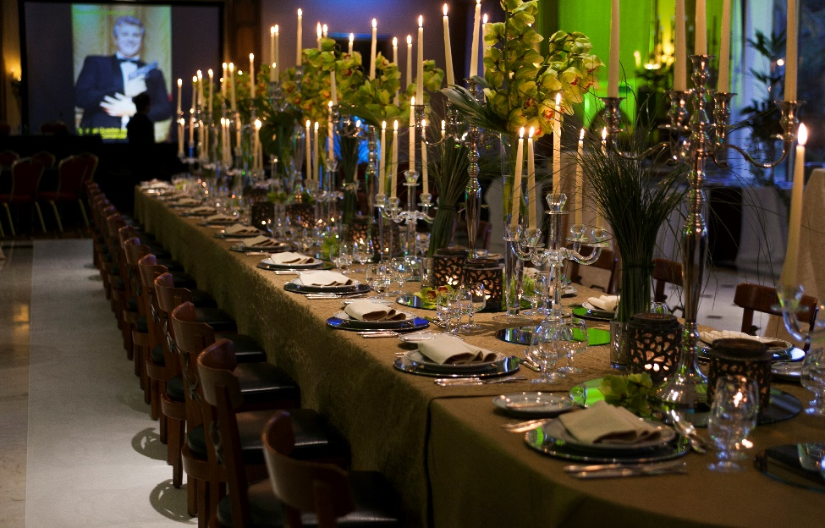
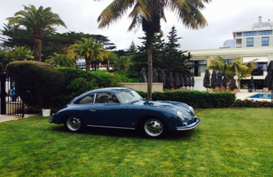
The Hotel Palácio also organizes all type of corporate events.

Slide 24
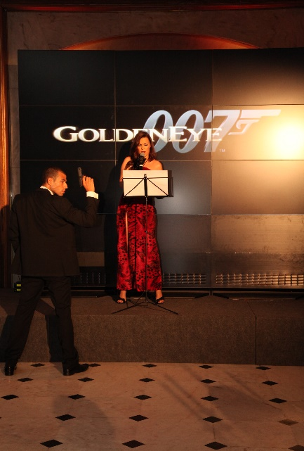
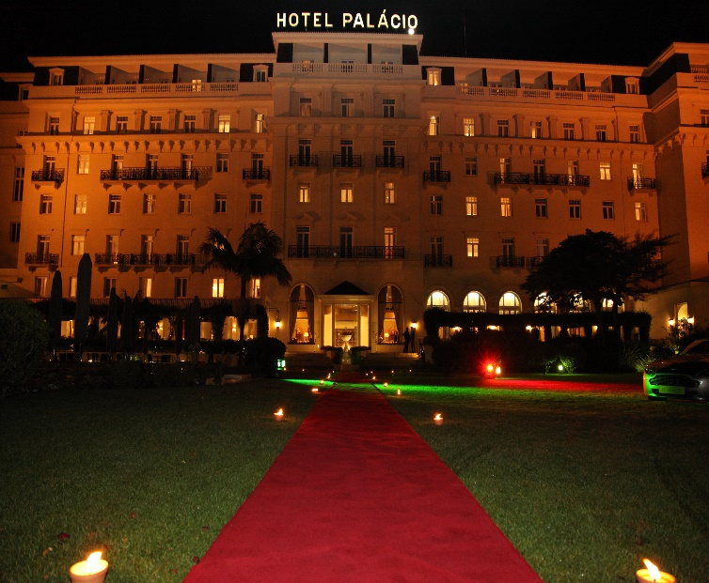
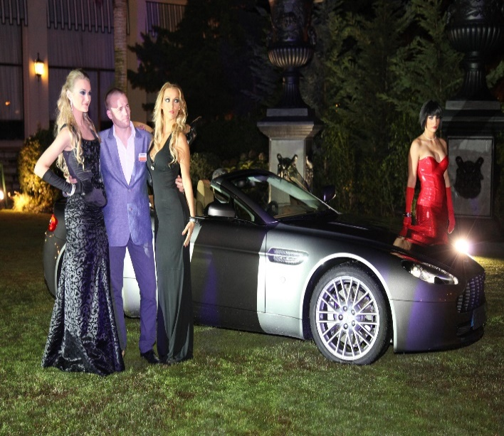
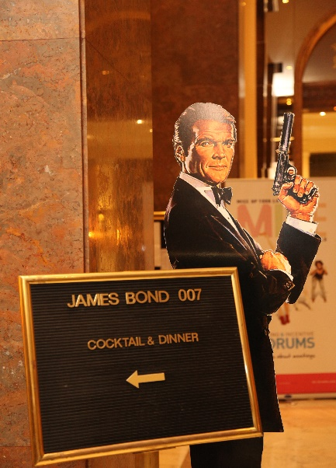
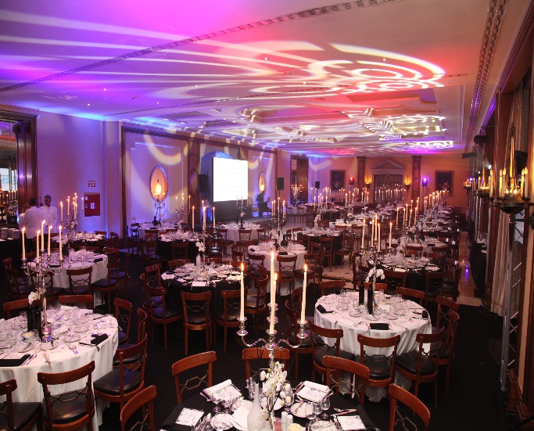
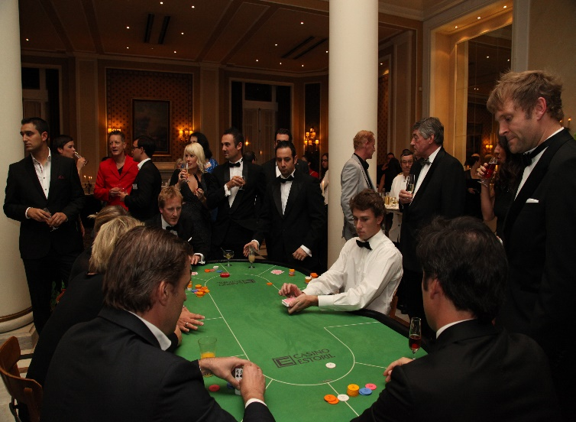
We create and design 007 corporate events..

Slide 25
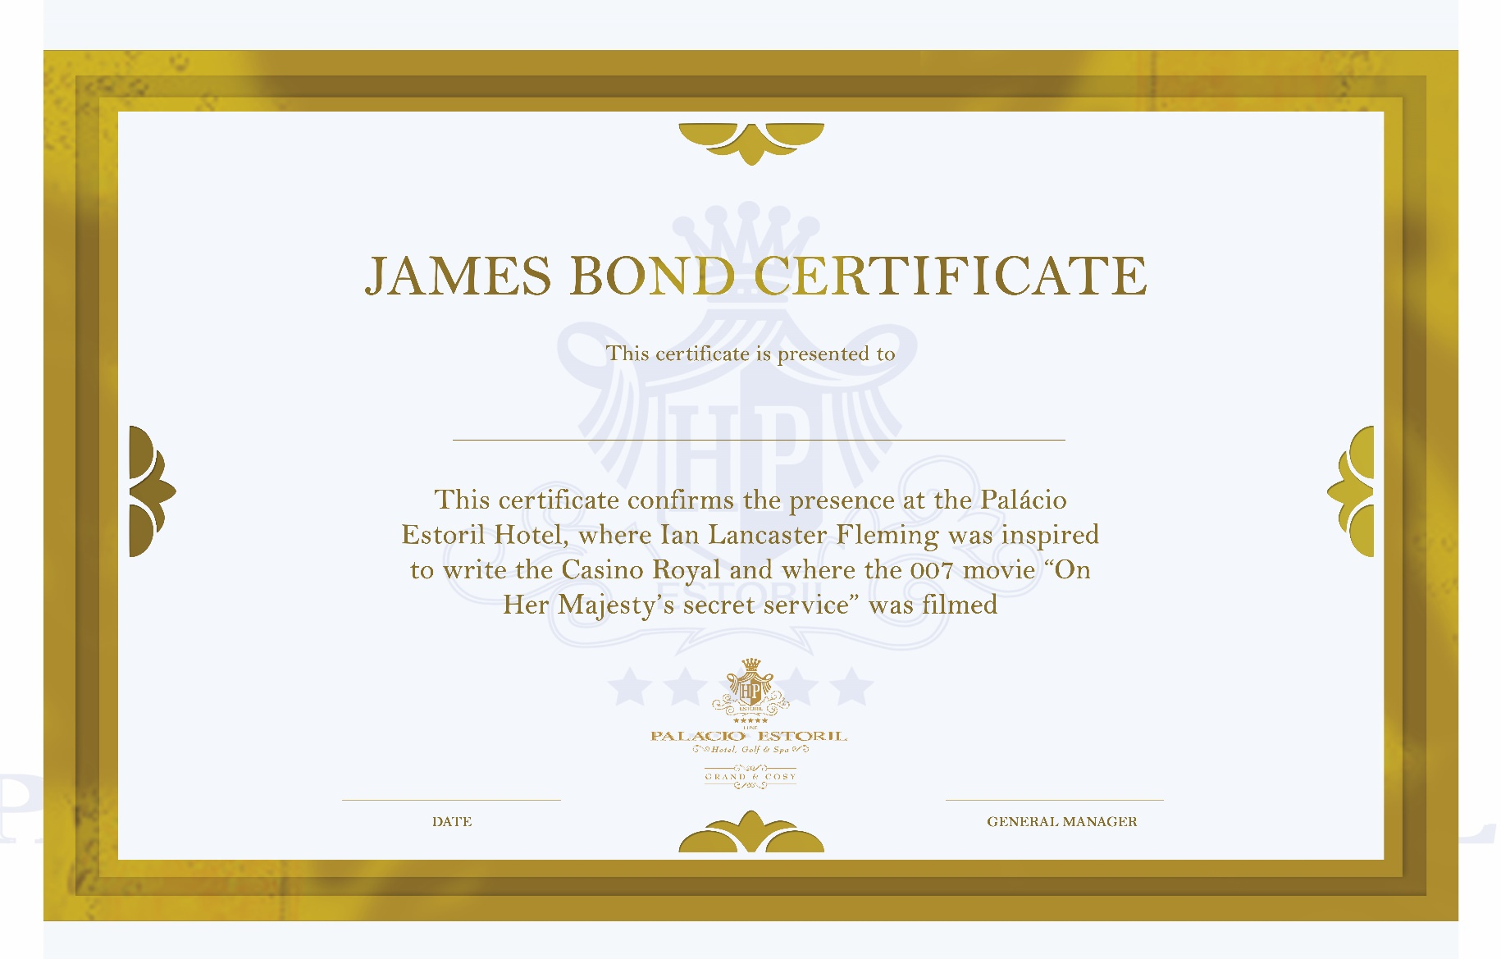
And your clients will get a certificate…

Slide 26
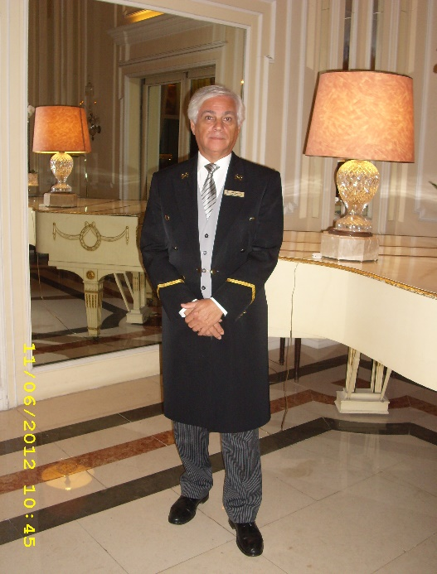

Unique selling points:
•Location:
In the center of Estoril, next to the casino and the beach.
A 20 minutes from Lisbon city center.
A 30 minutes from Lisbon airport
•Tradition: 87 years of history and experience.
•Hospitality: Dedicated service and very well trained staff (50% of the staff have been working in the Palácio over 25 years)

Slide 27
“As always the best service and hospitality.” Prince Paul of Romania

Slide 28

HOPE TO SEE YOU IN PORTUGAL!

